Slide 1
Style Guide

Slide 2
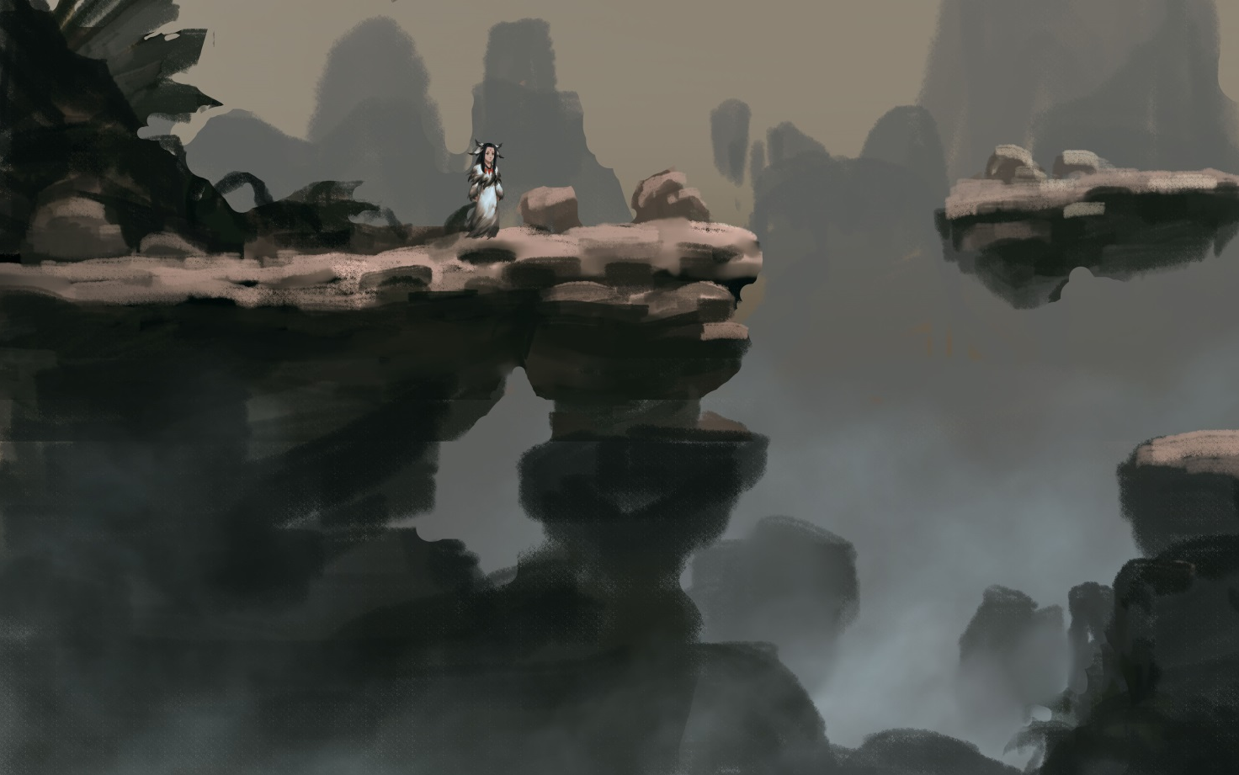
Overview
Cartoon
Simple
Asian

Slide 3
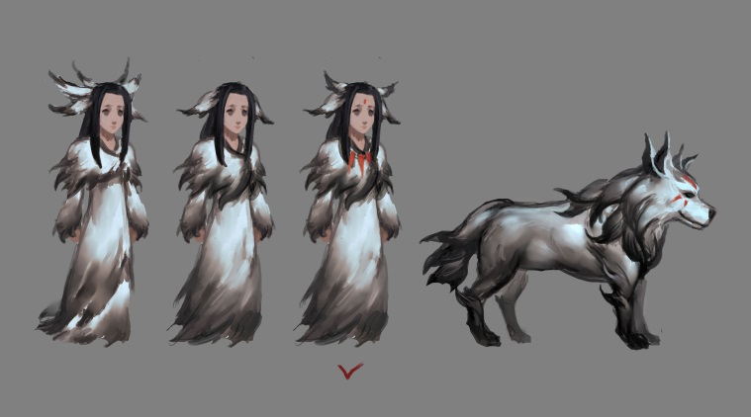

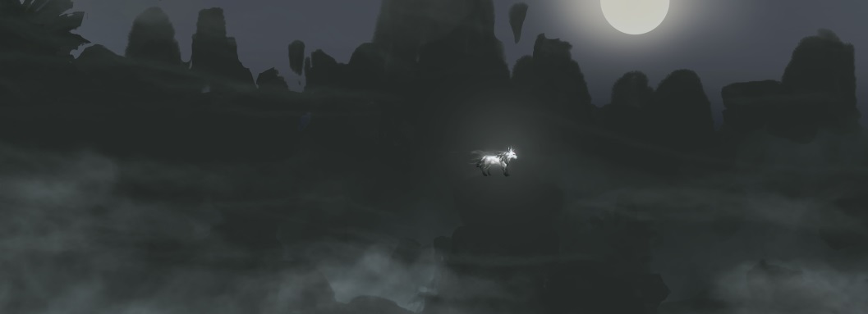
Characters and Level
Simple Shape
Ink painting style
Dark time and light time

Slide 4

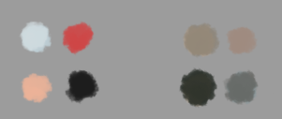
Palette
Characters
Strong Contrast
Brightness
Environment
Analogous
Darker

Slide 5

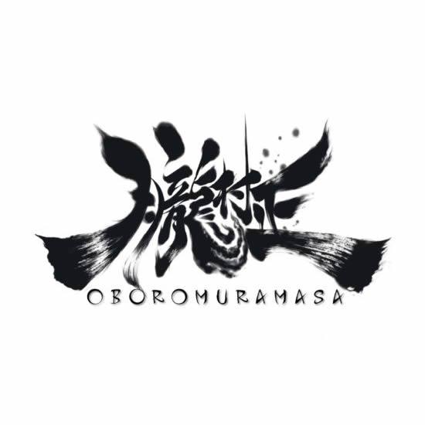


UI and Logo
Logo
Visible
Ink
UI
Readability
Simple
Asian style

